Slide 1
AI-Systems Distributed Deep Learning (Part II) (294-162)
Amir Gholami & Joseph E. Gonzalez

Slide 2
Acknowledgments
Many slides from Shigang Li, Prof. Kurt Keutzer, Pallas Group

Slide 3
Agenda for Today
1:10-1:40: Final Lecture on Parallel Training
1:40-1:45: Project Proposal Format
2:00-2:45: PC Meeting Discussions
2:45-3:00: Break
3:00-4:00: Guest Lecture by Michael Houston

Slide 4
Objectives For Today
Quick Review of Data & Pipeline Parallelism
Spatial Parallelism
Model Parallelism

Slide 5
Distributed Deep Learning: Summary So Far

Slide 6
Parallel and distributed training
Data parallelism
Pipeline parallelism
Model parallelism
Pros:
a. Make large model training feasible
b. No collective, only P2P
Cons:
a. Bubbles in pipeline
b. Removing bubbles leads to stale weights
Pros:
a. Make large model training feasible
Cons:
b. Communication for each operator (or each layer)
Pros:
a. Easy to realize
Cons:
a. Not work for large models
b. High allreduce overhead
Slide: Courtesy of Shigang Li

Slide 7


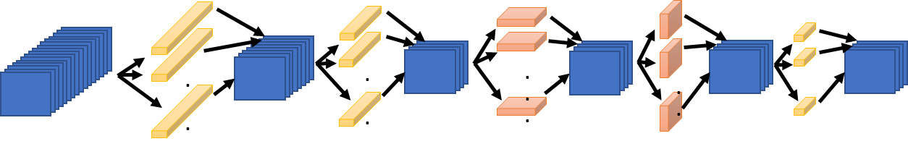
Synchronous Data Parallelism
1024
Compute the entire model on each processor
Distribute the batch evenly across each processor:
1024 batch distributed over 16 PEs: 64 images per GPU
Communicate gradient updates through allreduce
GPU 1
GPU 2
GPU 3
GPU 16
64
64
64
64
fprop
fprop
fprop
fprop
…
bprop
bprop
bprop
bprop
MPI ALLREDUCE

Slide 8
Generalization Gap Problem
Larger batch sizes harm generalization performance.
Goyal, Priya, et al. "Accurate, large minibatch SGD: Training imagenet in 1 hour." arXiv preprint arXiv:1706.02677 (2017).

Slide 9
Data Parallelism Summary
An efficient parallel training method where the comm time is independent of processors with ring allreduce
Very easy to implement. Only requires allreduce operation before updating parameters
Very challenging to scale. Using large batch training is not an option as it hurts generalization performance.
Existing solutions often require a lot of tuning (outside of ResNet-50 on ImageNet)
Does not work for large models such as GPT-3 which are too large to fit in one GPU

Slide 10
Parallel and distributed training
Data parallelism
Pipeline parallelism
Model parallelism
Pros:
a. Make large model training feasible
b. No collective, only P2P
Cons:
a. Bubbles in pipeline
b. Removing bubbles leads to stale weights
Pros:
a. Make large model training feasible
Cons:
b. Communication for each operator (or each layer)
Pros:
a. Easy to realize
Cons:
a. Not work for large models
b. High allreduce overhead
Slide: Courtesy of Shigang Li

Slide 11
Pipeline Parallelism
Bubble where processes are idle
Time

Slide 12
Chimera: Bidirectional Pipeline
Big idea: Replicate the model to the other processes so that we can do forward pass in two directions
Slide: Courtesy of Shigang Li

Slide 13
Summary
Slide: Courtesy of Shigang Li

Slide 14
Pipeline Parallelism Summary
More efficient for large scale training to thousands of processes where point-to-point communication is much cheaper than collective operations such as allreduce or all-gather
Slightly more involved algorithm than data parallel method but with the advantage of only requiring point to point communication
Requires special handling of bubble that results in idle processes

Slide 15
Spatial Parallelism

Slide 16
Spatial Parallel Training
The general idea is to break the input into smaller pieces and distribute the work among different processors
Need to exchange boundary points for spatial convolutions
P0
P1
P2
P3
Peter Jin, Boris Ginsburg, and Kurt Keutzer. "Spatially Parallel Convolutions" ICLR Workshop Track, 2018
Notes:
\begin{align*}
T_{{comm}}({domain}) = &\sum_{i=1}^{L}\left(\alpha + \beta B X^i_WX^i_C{k^i_h/2}\right)\\
+ &\sum_{i=1}^{L}\left(\alpha + \beta B Y^i_WY^i_C{k^i_w/2}\right)\\
+2&\sum_{i=1}^{L}\left(\alpha {\log(P)}+ \beta \frac{P-1}{P} |W_i|\right)
\end{align*}
\begin{align*}
T_{{comm}}({domain}) = &\sum_{i=1}^{L}\left(\beta B X^i_WX^i_C{k^i_h/2}\right)\\
+ &\sum_{i=1}^{L}\left(\beta B Y^i_WY^i_C{k^i_w/2}\right)\\
+2&\sum_{i=1}^{L}\left(\beta \frac{P-1}{P} |W_i|\right)
\end{align*}

Slide 17
Communication Complexity
Exchanging horizontal pixels
Exchanging vertical pixels
All reduce Cost
(same as before)
X_{W}
P0
P1
X_{H}
P2
P3
Peter Jin, Boris Ginsburg, and Kurt Keutzer. "Spatially Parallel Convolutions" ICLR Workshop Track, 2018.
Gholami, Amir, Ariful Azad, Peter Jin, Kurt Keutzer, and Aydin Buluc. "Integrated model, batch, and domain parallelism in training neural networks." SPAA, 2018.

Slide 18
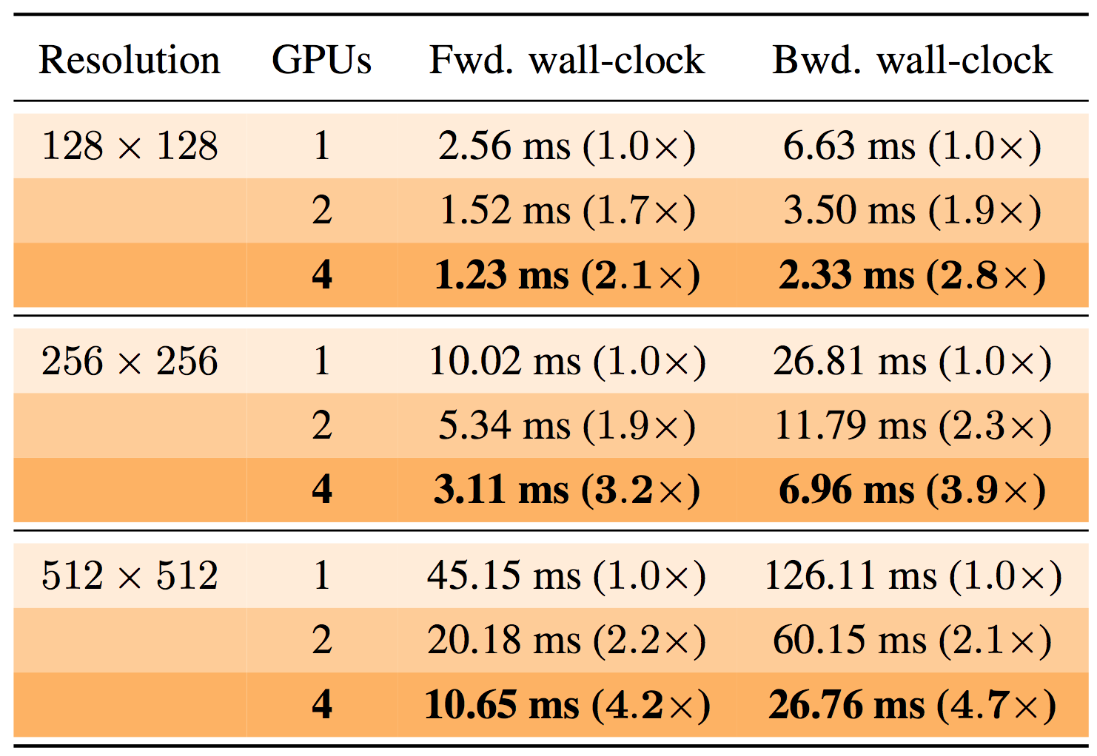

Useful for High Resolution Training
Domain parallel scaling on V100 GPUs
3x3 Conv, Batch=32, Channel=64
Peter Jin, Boris Ginsburg, and Kurt Keutzer. "Spatially Parallel Convolutions" ICLR Workshop Track, 2018
Figure from: Dumoulin, V., Visin, F.. A guide to convolution arithmetic for deep learning. arXiv:1603.07285, 2016.

Slide 19
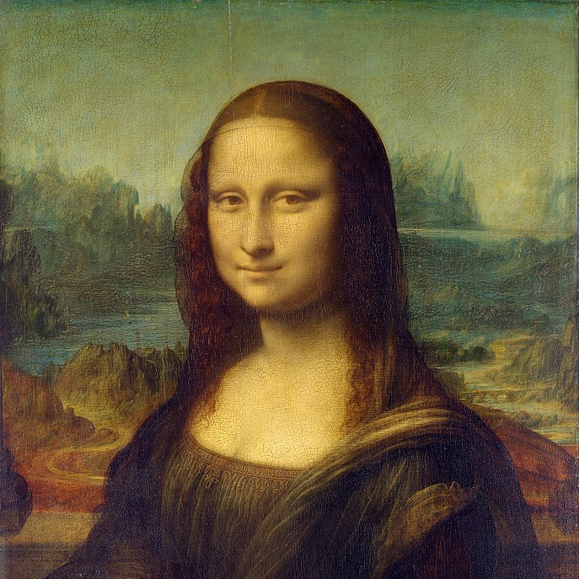
Spatial Parallelism Summary
A little harder to implement since you need to exchange the boundary points
Only effective for high resolution input data
Limits the number of processors that can be effectively utilized
GPU1
GPU2
GPU3
GPU4

Slide 20
Model Parallelism
AKA Operator Parallelism

Slide 21
Model Parallelism
Divide the model across machines and replicate the data.
Supports large models and activations
Requires communication within single evaluation
How to best divide a model?
Split across layers
Only one set of layers active a time → poor work balance
This is basically pipeline parallelism
Split individual layers
which dimension?
Weights or spatial → depends on operation

Slide 22
The AlexNet Architecture
Without GPU Partitioning

Slide 23
The Actual AlexNet Architecture
from the paper

Slide 24
Training on Multiple GPUs
Limited by GPU memory using Nvidia GTX 580 (3GB RAM)
60M Parameters ~ 240 MB
Need to cache activation maps for backpropagation
Batch size = 128
128 * (227*227*3 + 55*55*96*2 + 96*27*27*2 + 256*27*27*2 + 256*13*13*2 + 13*13*384*2 + 256*13*13 + 6*6*256 + 4096 + 4096 + 1000) *4 Bytes ~ 782MB Activations
That is assuming no overhead and single precision values
Tuned splitting across GPUS to balance communication and computation
Image from https://neurohive.io/en/popular-networks/alexnet-imagenet-classification-with-deep-convolutional-neural-networks/

Slide 25
Model Parallelism: Comm Analysis
It helps to think of the operations in matrix form. Consider an FC layer
Data Parallelism: Partition input across different Processors (batch dimension)
Model Parallelism: Partition weights across different Processes (W dimension)
Requires communication
Let’s discuss the communication details, step by step
Notes:
\begin{align*}
T_{{comm}}({domain}) = &\sum_{i=1}^{L}\left(\alpha {\log(P)}+ \beta \frac{P-1}{P} d_i\right)\\
+2&\sum_{i=2}^{L}\left(\alpha {\log(P)}+ \beta \frac{P-1}{P} d_{i-1}\right)
\end{align*}

Slide 26
Comm Analysis: Forward Pass
d_{i}
B
B
Requires All Gather communication
P₀
P₀
P₁
P₀
P₀
P₁
d_{i}/P
d_{i}/P
*
d_{i}
P₁
P₁
W
X
Y^{local}
Y
Requires an all gather communication so that all processes get each others activation data
Same cost as all reduce without the 2x factor
* Ignoring latency term for notational simplicity
Notes:
\begin{align*}
\sum_{i=1}^{L} \beta (P-1) \frac{Bd_i}{P}\right)
\end{align*}
\begin{align*}
T_{{comm}}({domain}) = &\sum_{i=1}^{L}\left(\alpha {\log(P)}+ \beta \frac{P-1}{P} Bd_i\right)\\
+2&\sum_{i=2}^{L}\left(\alpha {\log(P)}+ \beta \frac{P-1}{P} d_{i-1}\right)
\end{align*}

Slide 27
Backward Pass: Weights
P₀
P₁
P_{0,} P₁
P₀
d_{i}/P
*
P₁
X^{T}
∇_{Y}
∇_{W}
No communication needed as every processor only needs the gradient of its own parameters
This makes model parallelism very effective for cases where the model size is large
Notes:
\begin{align*}
\sum_{i=1}^{L} \beta (P-1) \frac{Bd_i}{P}\right)
\end{align*}
\begin{align*}
T_{{comm}}({domain}) = &\sum_{i=1}^{L}\left(\alpha {\log(P)}+ \beta \frac{P-1}{P} Bd_i\right)\\
+2&\sum_{i=2}^{L}\left(\alpha {\log(P)}+ \beta \frac{P-1}{P} d_{i-1}\right)
\end{align*}

Slide 28
Backward Pass: Inputs
P₀
d_{i}
B
Requires All Reduce communication
P₀
P₁
P₀
P₁
P₀
P₁
d_{i}/P
*
d_{i}
P₁
W^{T}
∇_{Y}
∇_{X}
∇_{X} ^{local}
Aggregating input gradient requires an allreduce operation
Notes:
\begin{align*}
2\sum_{i=2}^{L}\left(\beta (P-1) \frac{Bd_i}{P}\right)
\end{align*}

Slide 29
Comm Complexity Analysis
In Model Parallelism we need two forms of communication:
All Gather operation so that all processors get all the activations
All reduce operation for backpropagating activation gradients
All Gather
All Reduce
Notes:
\begin{align*}
\sum_{i=1}^{L}\left(\beta (P-1) \frac{Bd_i}{P}\right) + 2\sum_{i=2}^{L}\left(\beta (P-1) \frac{Bd_i}{P}\right)
\end{align*}

Slide 30
Model vs Data Parallelism?
When does it make sense to use Model vs Data Parallelism?
Model parallelism reduces the quadratic complexity of d_{i}
It is useful for layers with very large weights d_{i} >> 1
It makes sense to use an integrated/hybrid data and model parallelism
Gholami, Amir, Ariful Azad, Peter Jin, Kurt Keutzer, and Aydin Buluc. "Integrated model, batch, and domain parallelism in training neural networks." SPAA, 2018.
Notes:
\begin{align*}
\sum_{i=1}^{L}\left(\beta (P-1) \frac{Bd_i}{P}\right) + 2\sum_{i=2}^{L}\left(\beta (P-1) \frac{Bd_i}{P}\right)
\end{align*}
\begin{align*}
T_{{comm}}({data}) = \sum_{i=1}^{L}\left(\beta (P-1) \frac{d_i^2}{P}\right)
\end{align*}

Slide 31
Model Parallelism Summary
Has better comm complexity for large FC layers than Data parallel approach
Makes training large models feasible by breaking it into smaller parts
However, requires blocking collective communication during both forward pass (all gather), as well as backwards pass (all reduce)
Slightly harder to implement than data/pipeline parallel

Slide 32
Integrated Model and Data Parallelism
For a linear graph we can find the optimal hybrid method for analyzing the communication complexity, coupled with hardware utilization [1]
Processes are
2D indexed:
P= P_{r} x P_{c}
[1] Gholami, Amir, Ariful Azad, Peter Jin, Kurt Keutzer, and Aydin Buluc. "Integrated model, batch, and domain parallelism in training neural networks." SPAA, 2018.

Slide 33
General Hybrid Methods
For a general computational graph we need to decide on:
How many processes to assign for DP
Which axes to break the model: operator vs pipeline
How to efficiently map the GPUs to the resulting execution graph
…
For a general non-linear graph this leads to a combinatorically large search space

Slide 34
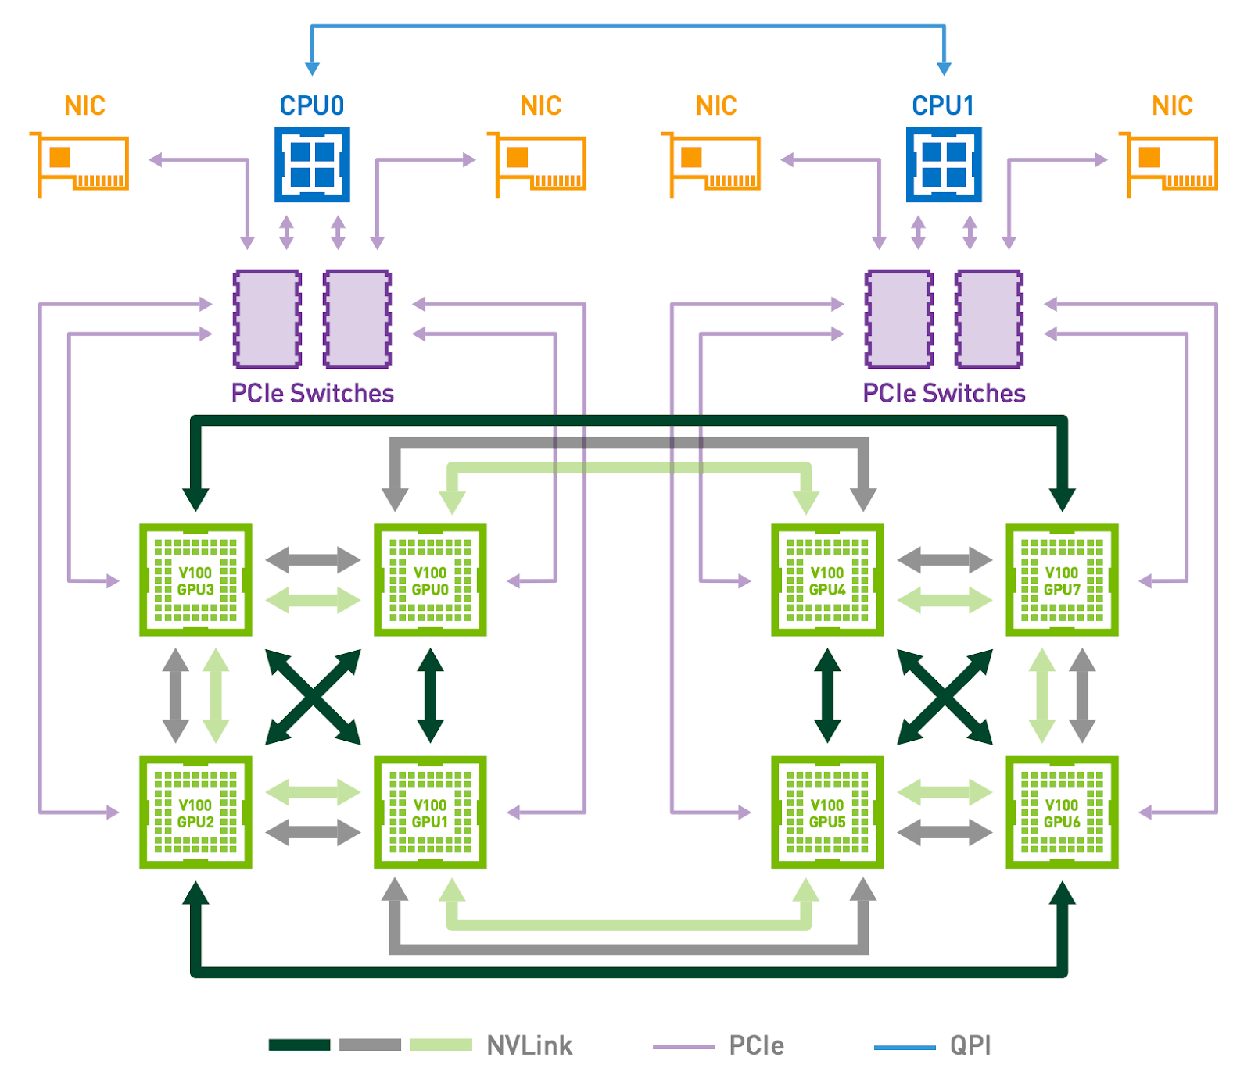
Hybrid Methods: Alpa
10-50 Gbps
Pipeline Parallelism*
(less communication)
*aka inter-op parallelism
Model Parallelism*
(more communication)
* aka intra-op parallelism
400 Gbps
Organize inter- and intra-op parallelism as a two-level hierarchical space
Design algorithms to derive optimal plans at each level
Slide: Courtesy of Lianming Zheng
Zheng, Lianmin, et al. "Alpa: Automating Inter-and Intra-Operator Parallelism for Distributed Deep Learning." arXiv preprint arXiv:2201.12023 (2022).

Slide 35
Alpa: Architecture Overview
locally optimal solution
solved by DP
Computational Graph
Device Cluster
Inter-op Pass
Stage 1
Stage 2
Stage N
locally optimal solution
solved by ILP
Intra-op Pass
Sharded
Stage 1
Sharded
Stage 2
…
Sharded
Stage N
Compiler
Runtime
Orchestration
Mesh
Executable 1
Mesh
Executable 2
Mesh
Executable N
Intra-op Parallelism
Device Mesh 1
Device Mesh 2
Device Mesh N
Runtime
Worker
D0
D1
D2
D3
Worker
D0
D1
D2
D3
Worker
Devices ...
…
Slide: Courtesy of Lianming Zheng
Zheng, Lianmin, et al. "Alpa: Automating Inter-and Intra-Operator Parallelism for Distributed Deep Learning." arXiv preprint arXiv:2201.12023 (2022).
Worker
D0
D1
D2
D3
Worker
D0
D1
D2
D3
Worker
Devices ...
…
…
…
Inter-op Parallelism

Slide 36
Project Proposals

